Slide 1
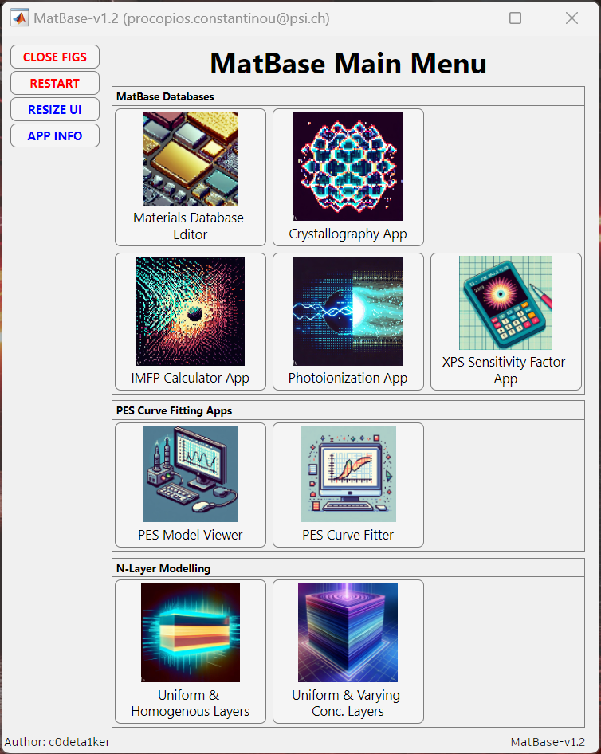

Slide 2
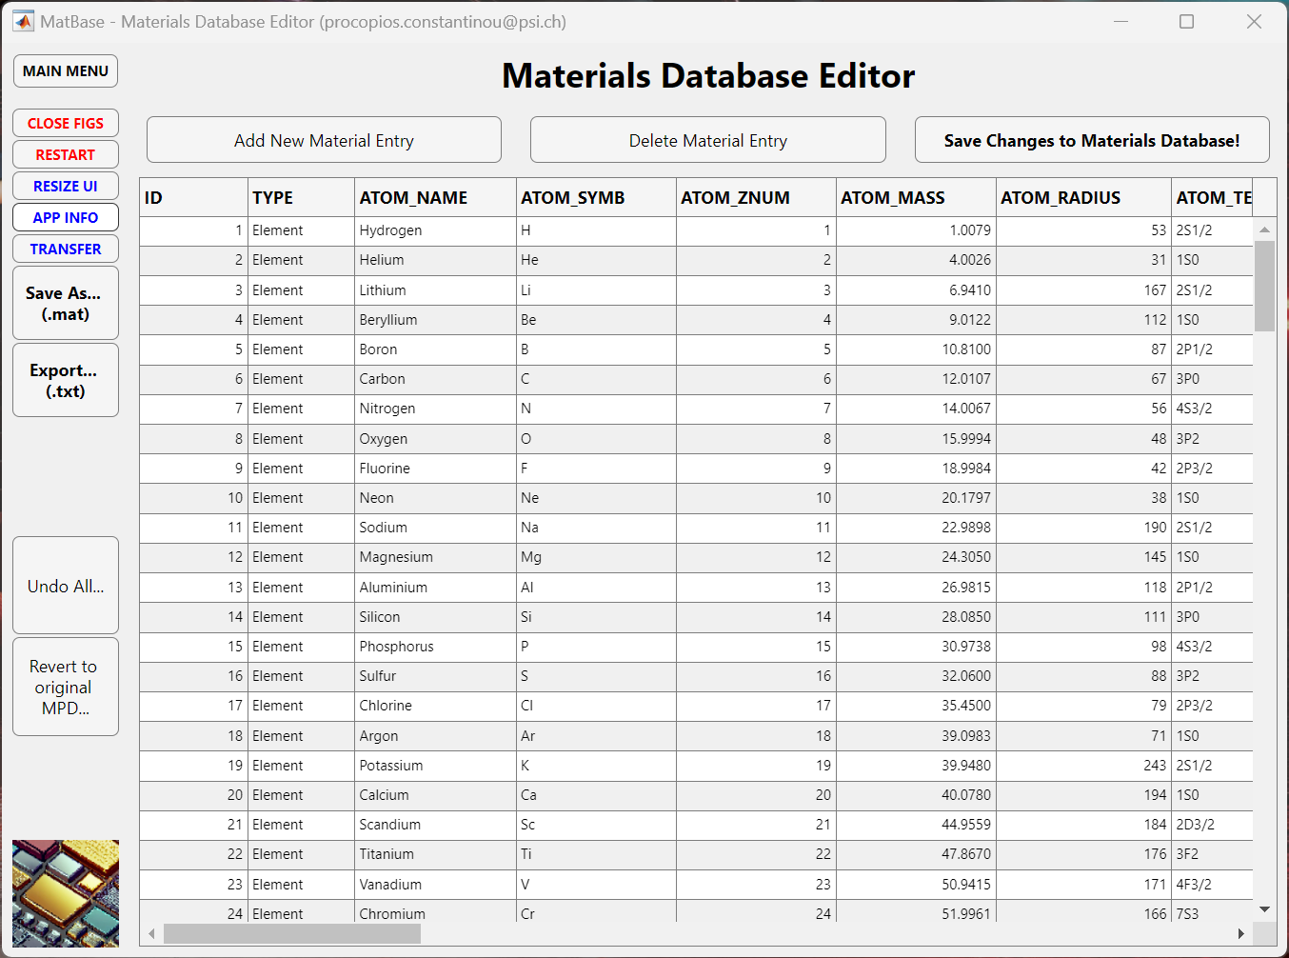
Currently 168 material entries with 42 properties each:
Database saved in ‘MPD_PCC.mat’ MATLAB file.
Elements, Oxides, Binary Semiconductors, Ionic Salts.
Use ‘get_mpd_props()’ to extract material properties.
Navigate to this App via ‘App_MatBase’ Main Menu.

Slide 3
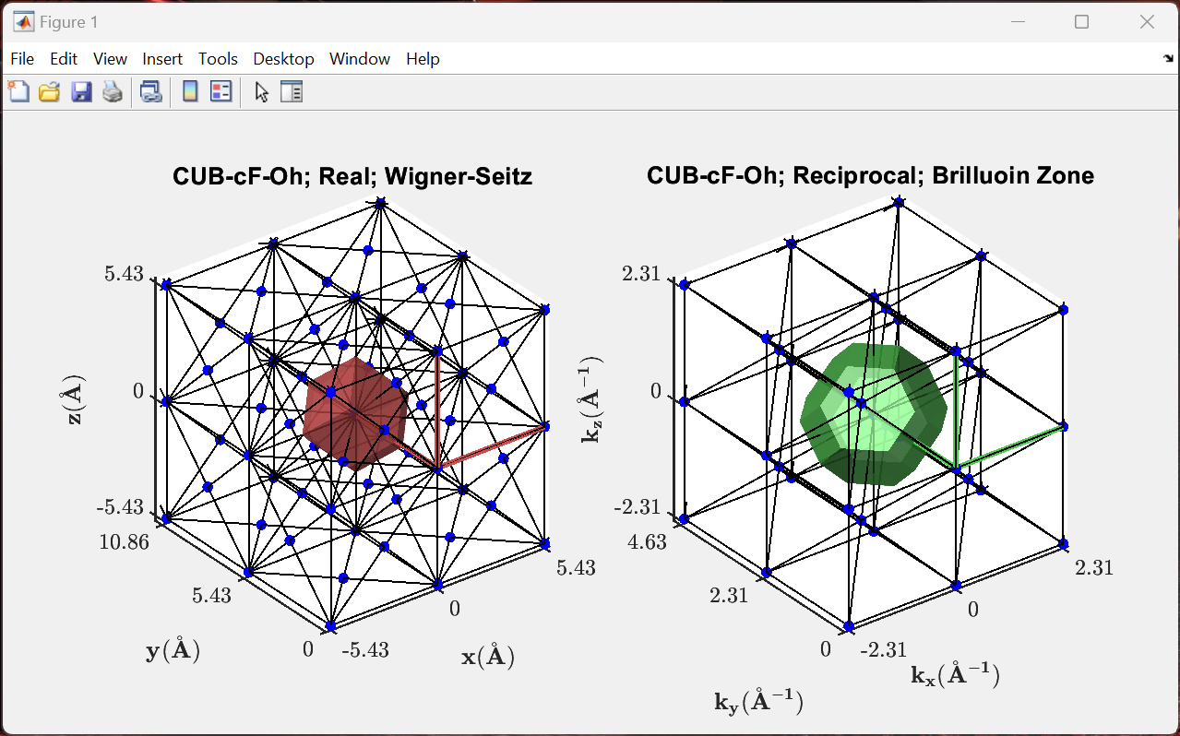
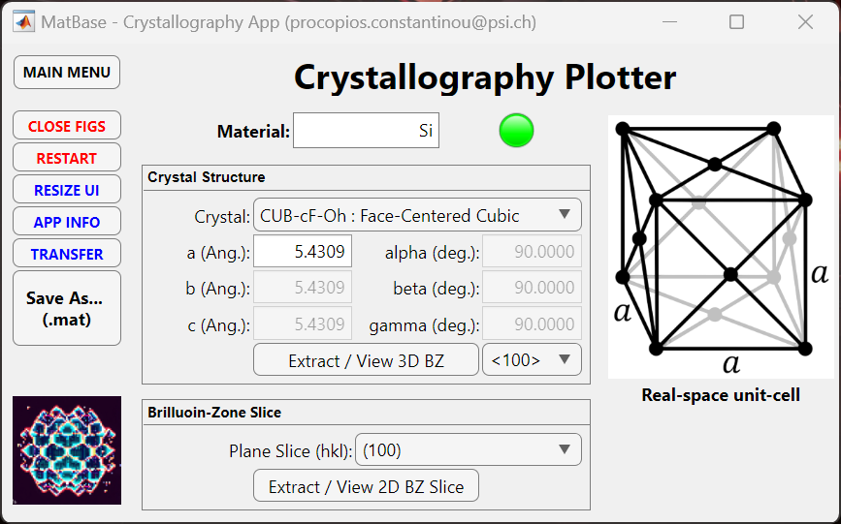
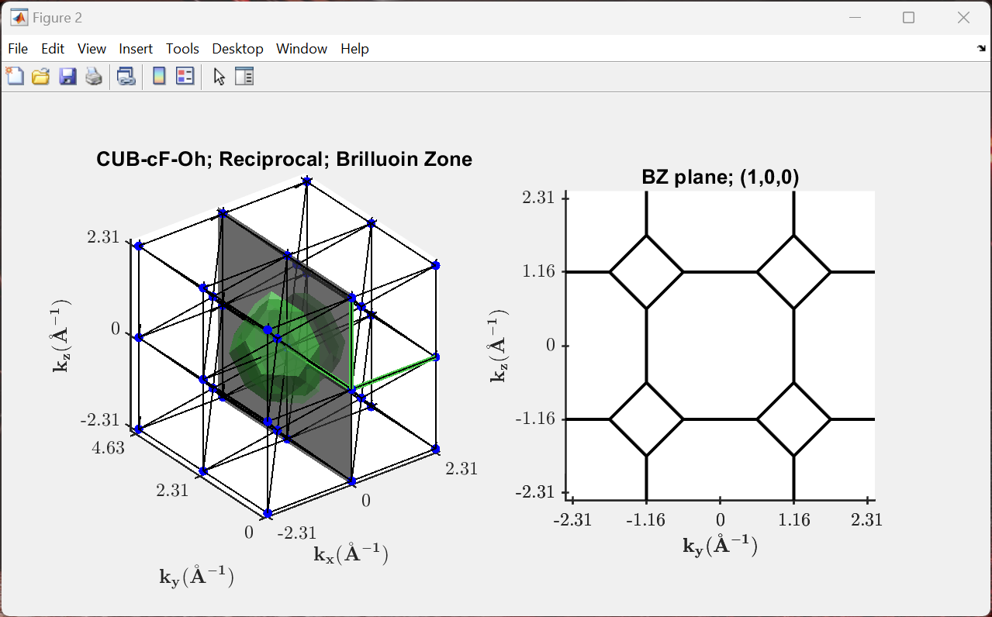
Access all material parameters from our database or manually enter data for materials not included.
Plot the 3D real- and reciprocal-space lattices.
Extract 2D slices through the Brillouin zone.
Navigate to this App via ‘App_MatBase’ Main Menu.

Slide 4
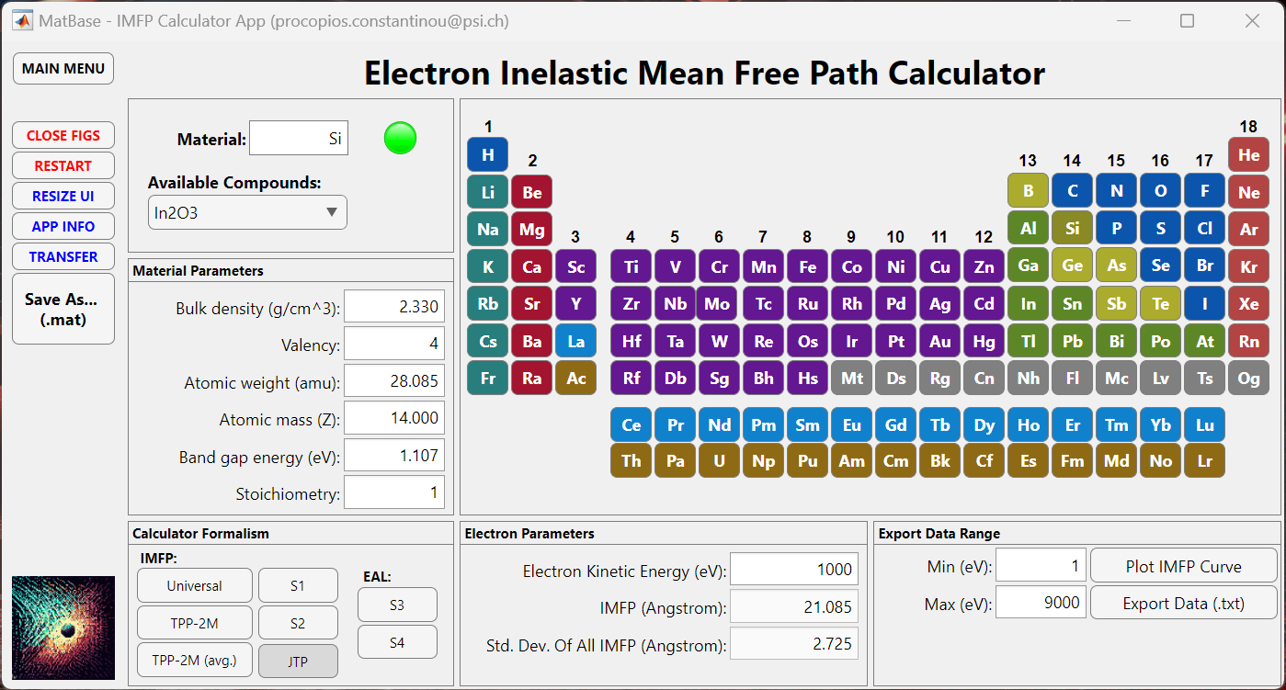
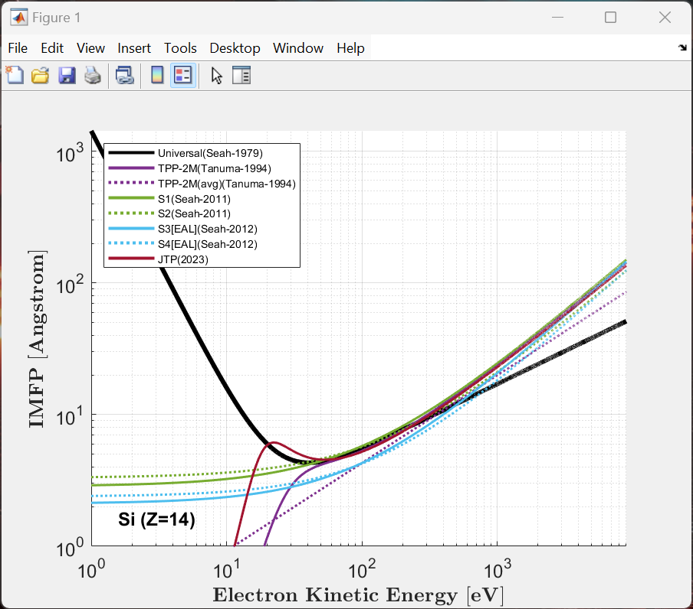
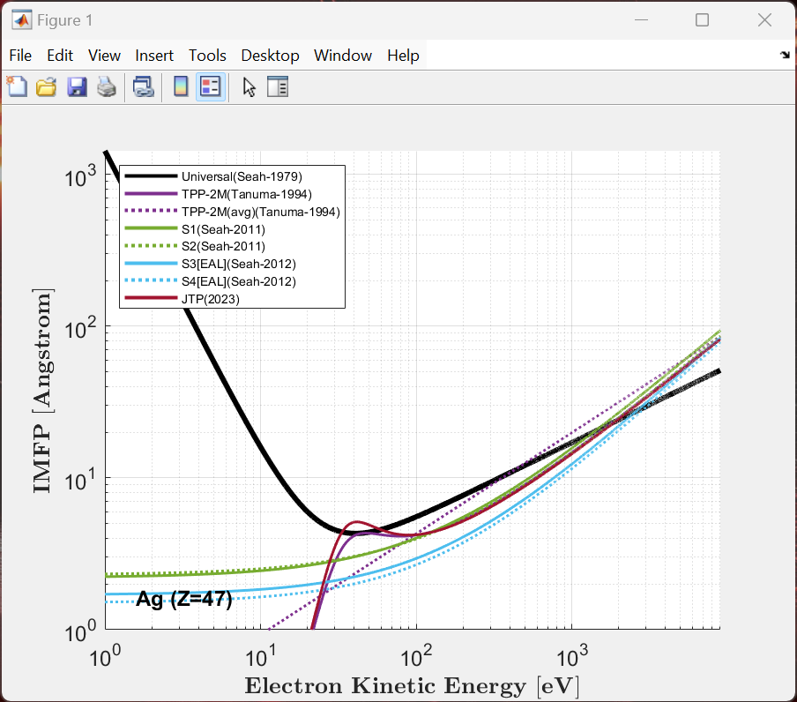
Access all material parameters from our database or manually enter data for materials not included.
Plot and calculate the IMFP using a range of formalisms; Universal, TPP-2M, S1, S2, S3, S4 & JTP methods.
Export IMFP data versus kinetic energy as a text file.
Use ‘calc_imfp()’ in MATLAB as a general IMFP calculator function.
Navigate to this App via ‘App_MatBase’ Main Menu.

Slide 5
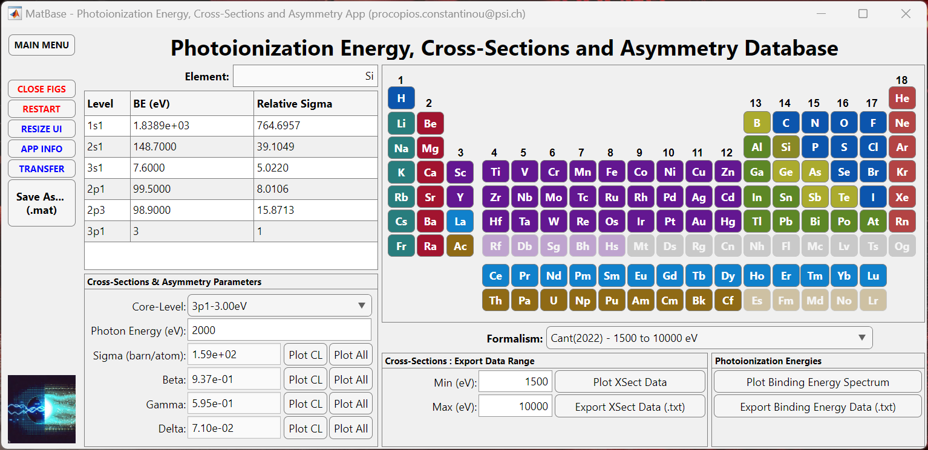
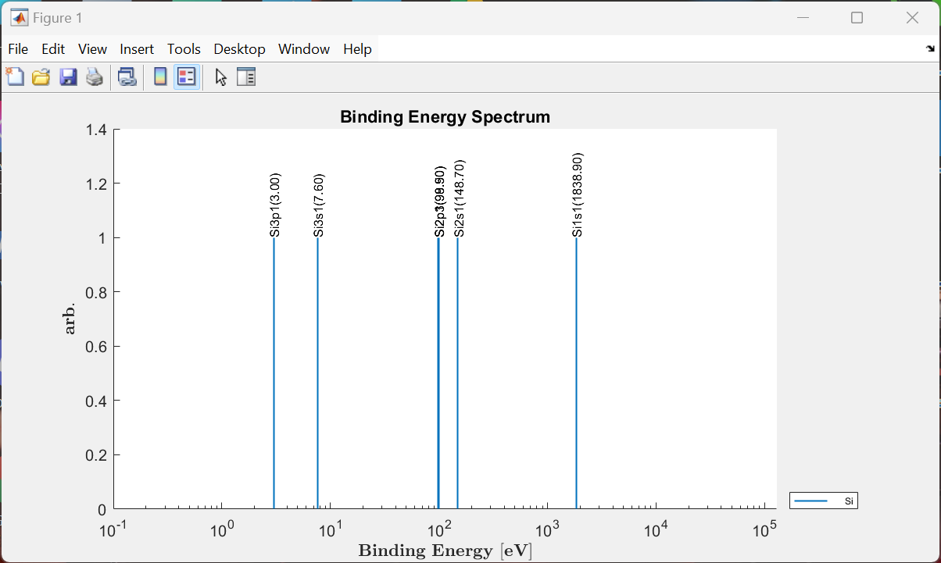
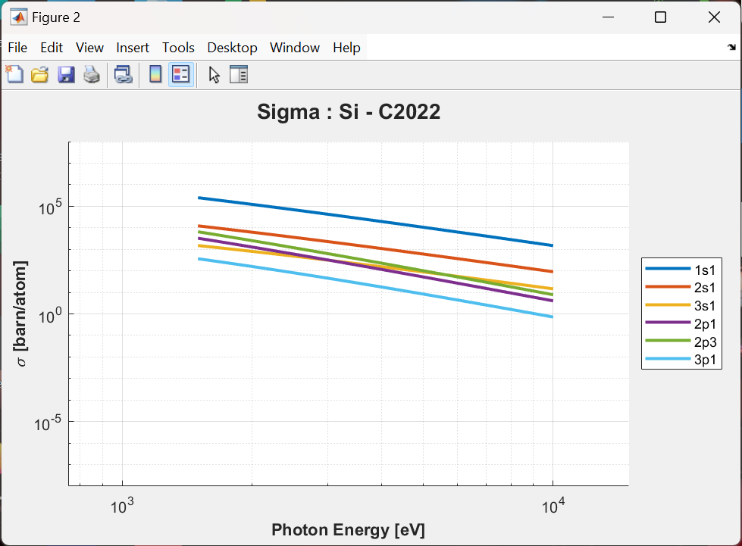
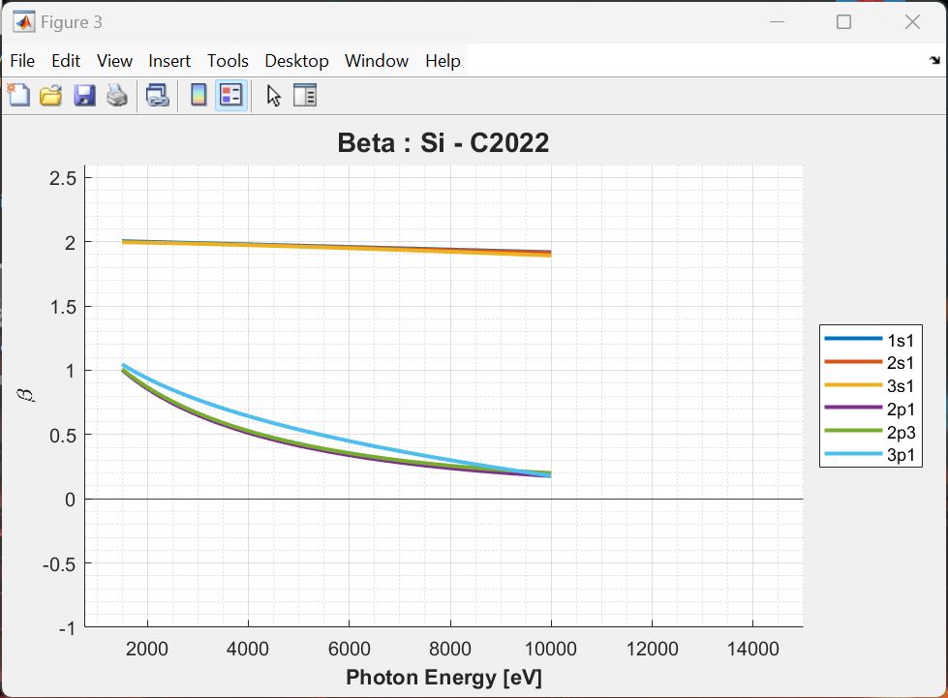
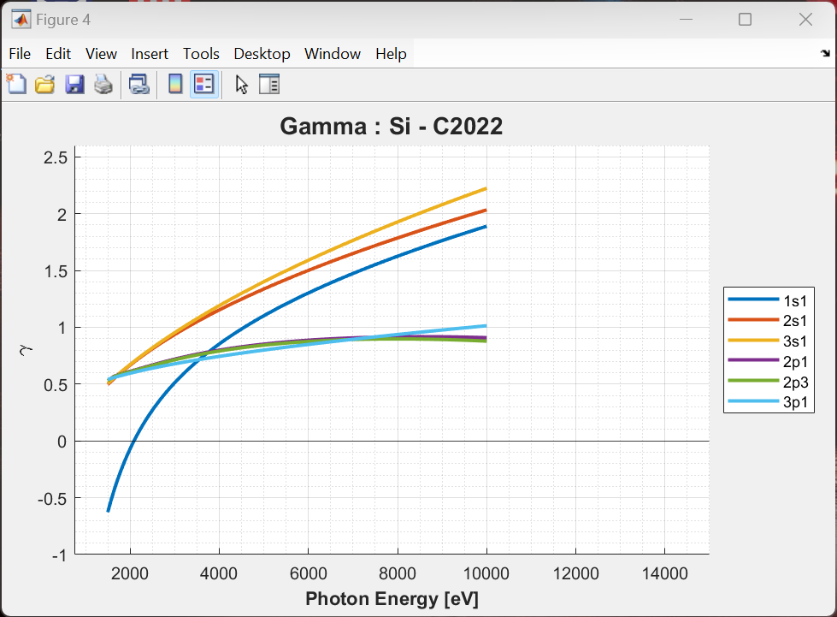
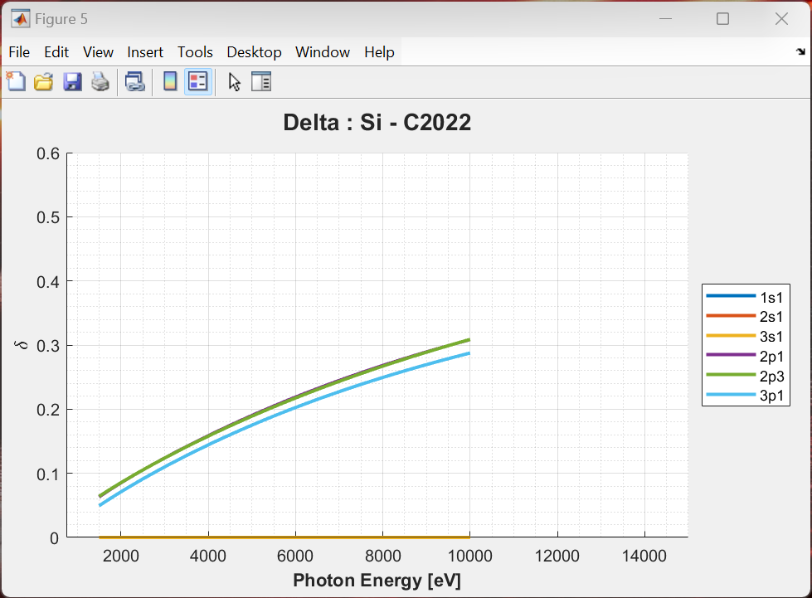
Elements 1 – 103 available.
Plot the binding energy spectrum, photoionization cross-sections, and photoionization asymmetry parameters.
Easily identify the best core-levels to probe by finding the maximum cross-sections.
Data from 4 different formalisms: Scofield (1973), Yeh & Lindau (1985), Trzhaskovskaya (2018) and Cant (2022).
Export any of the photoionization parameters as a text file.
Navigate to this App via ‘App_MatBase’ Main Menu.

Slide 6
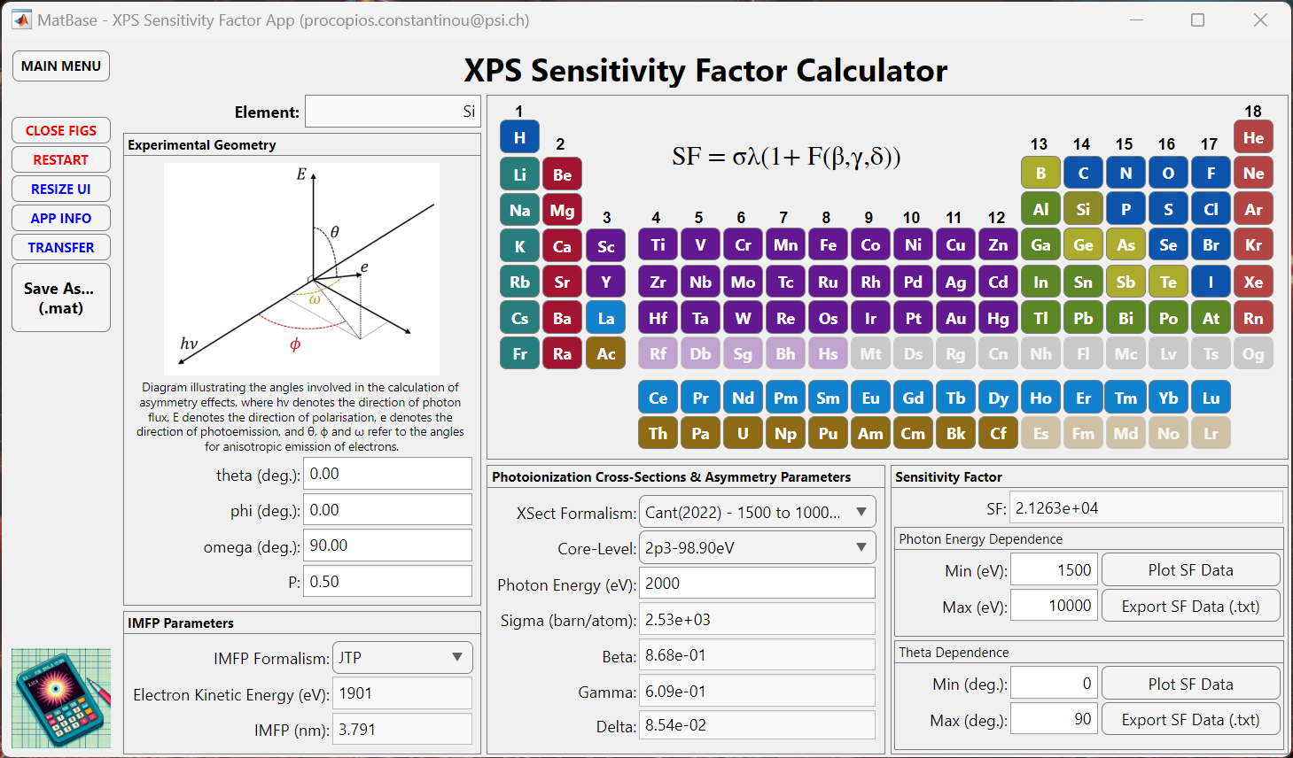
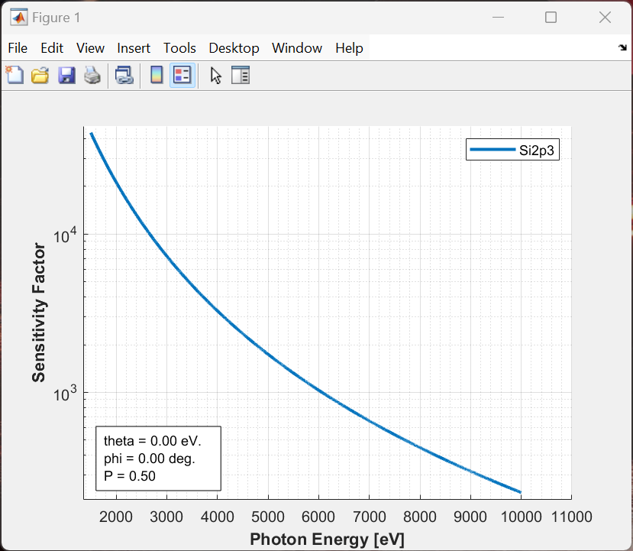
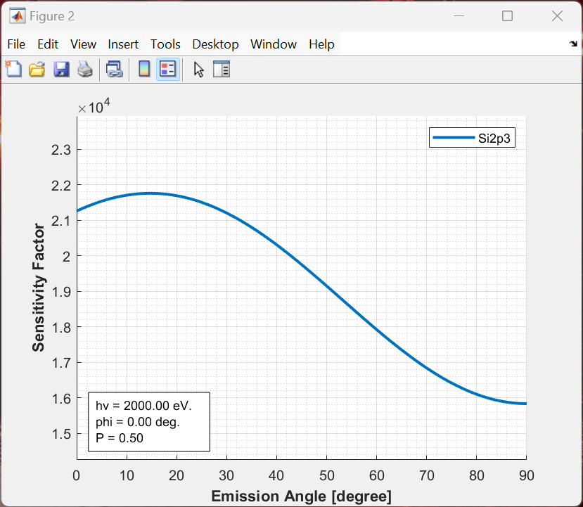
Elements 1 – 103 available.
Define your experiment setup and use the IMFP & Photoionization parameters databases to calculate the XPS sensitivity factor
Extract the Sensitivity Factor (SF) for PES quantification
Export the SF data as a text file.
Navigate to this App via ‘App_MatBase’ Main Menu.

Slide 7
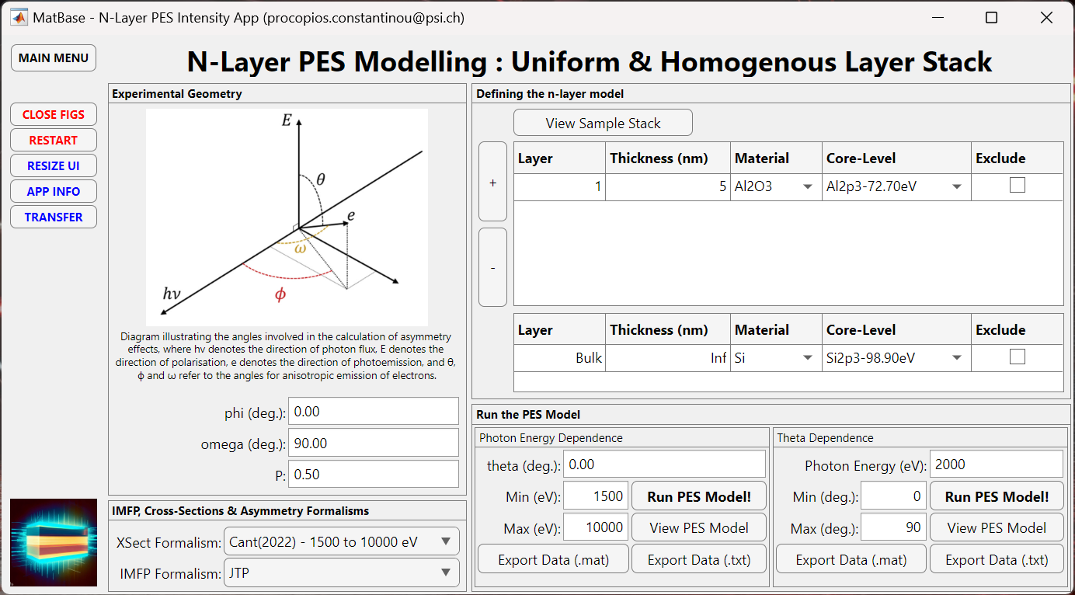
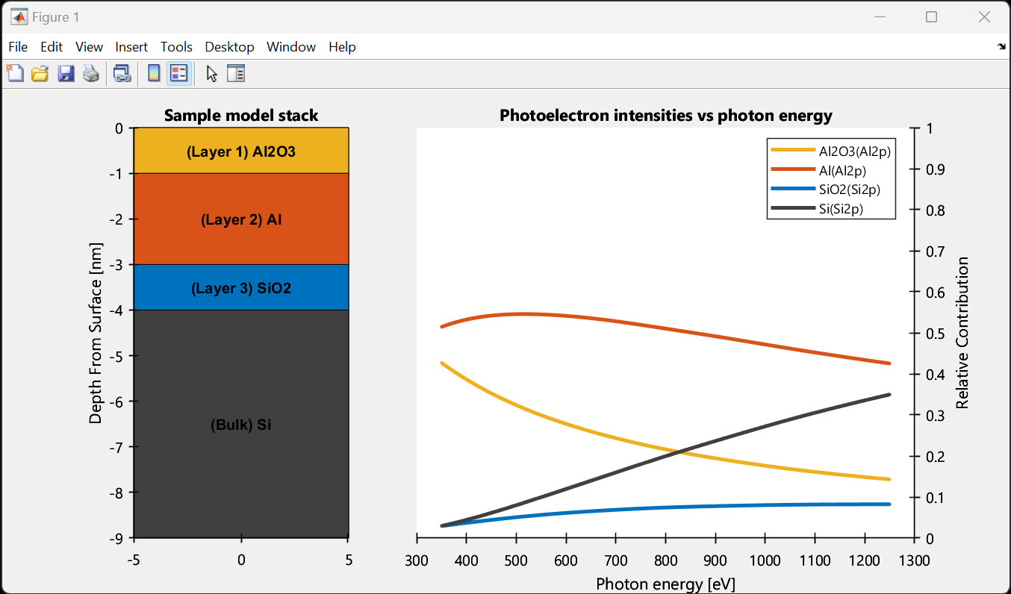
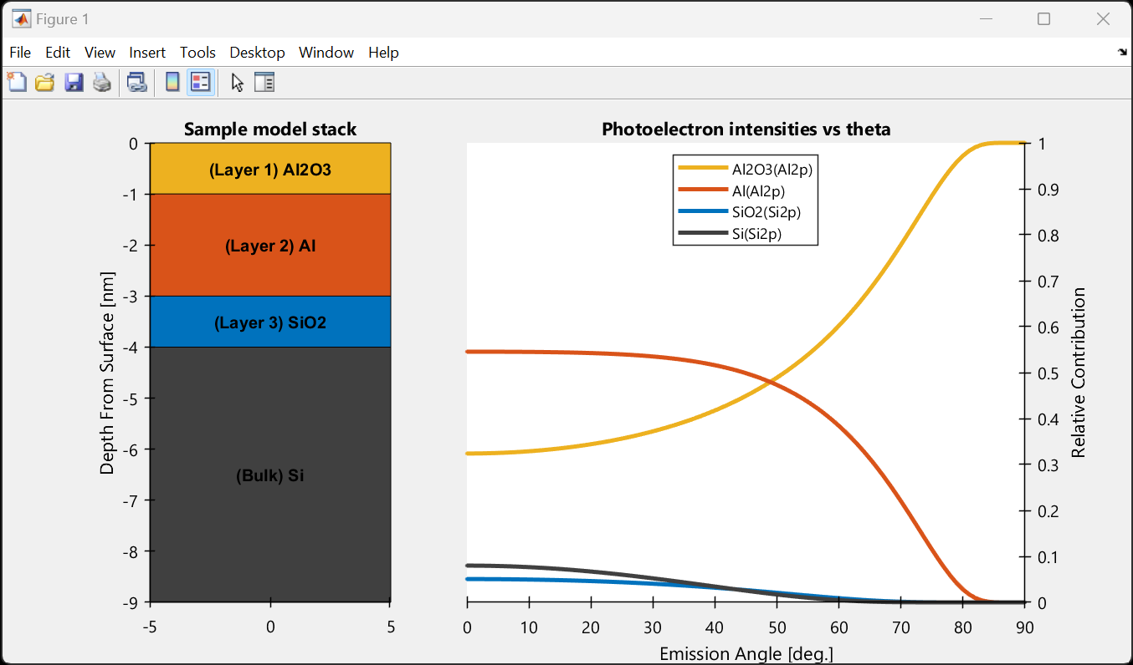
Access all material parameters from our database.
Access to photoionization cross-sections and photoionization asymmetry parameters from our database.
Easily define you N layered sample stack to plot the PES intensities from each layer versus photon energy or emission angle.
Export the data as a text file.
Navigate to this App via ‘App_MatBase’ Main Menu.

Slide 8
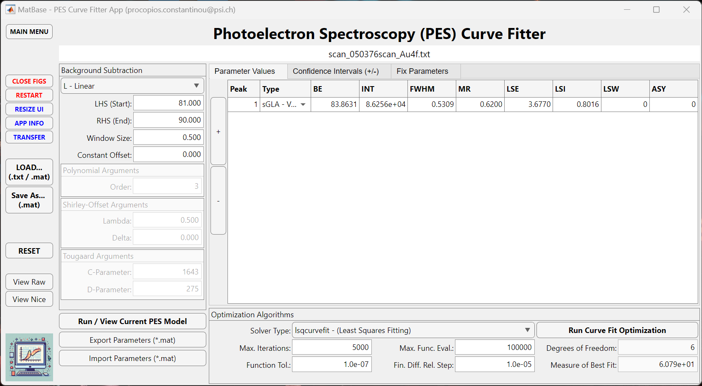
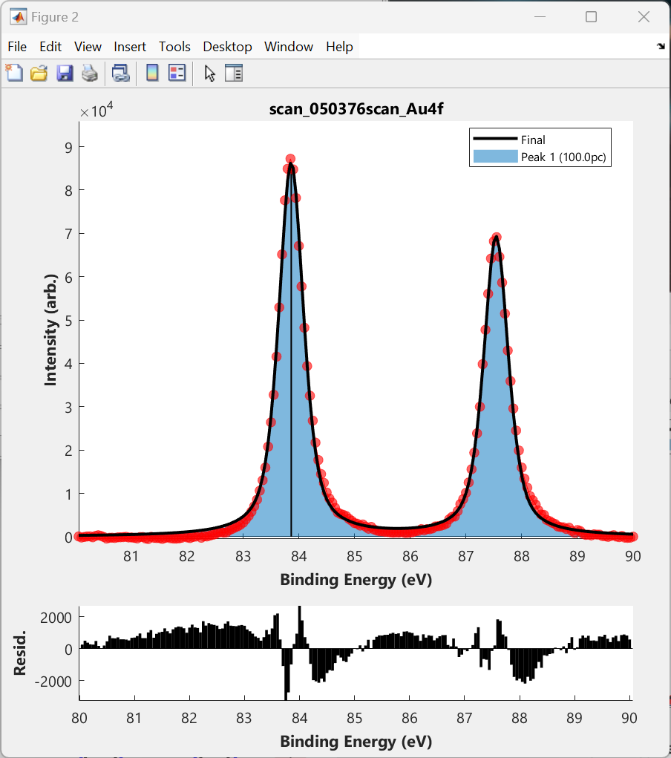
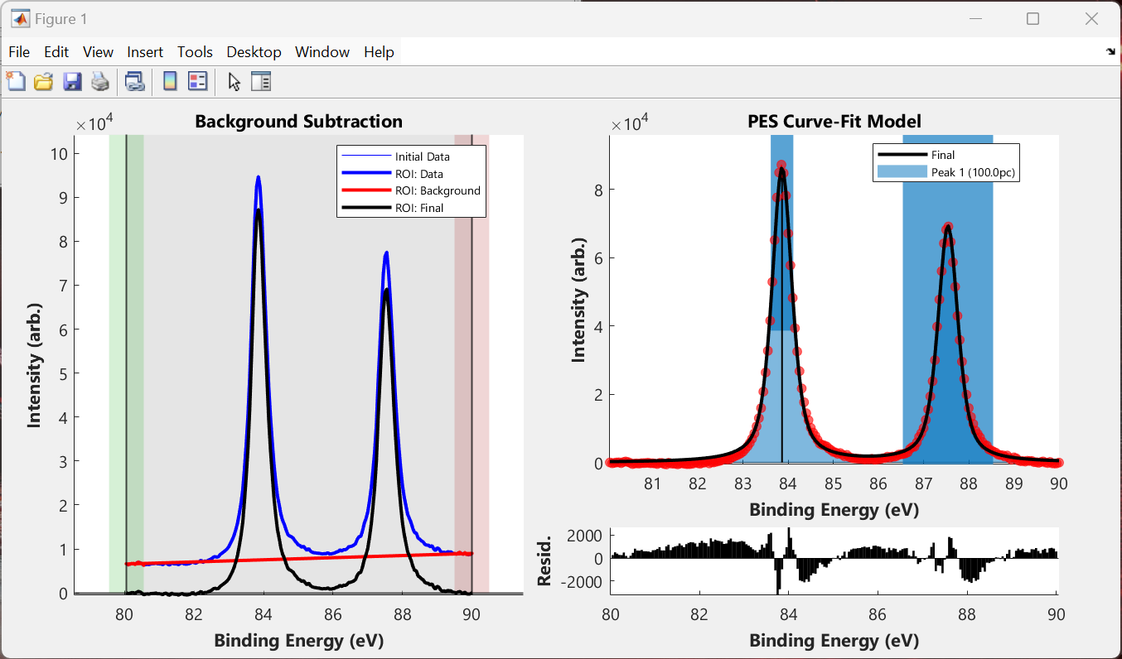

Slide 9
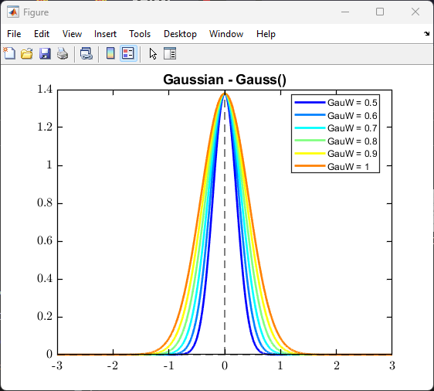
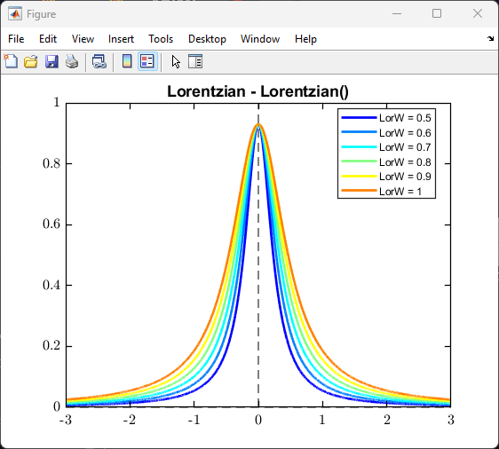
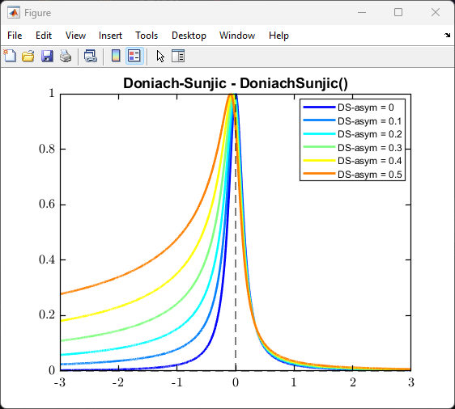
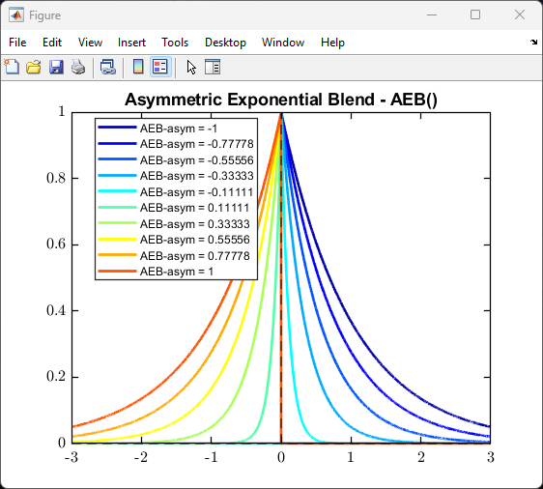
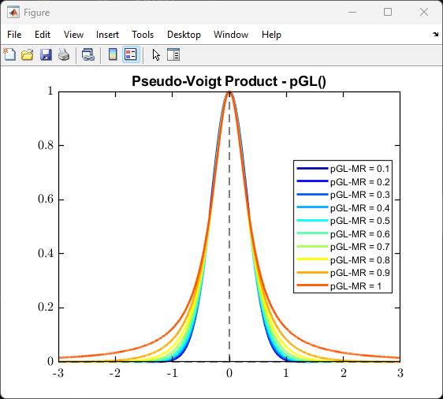
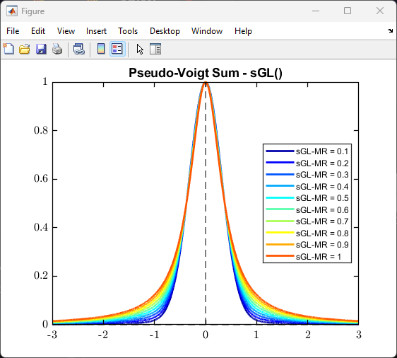
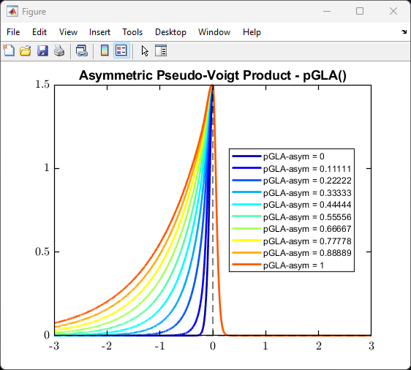
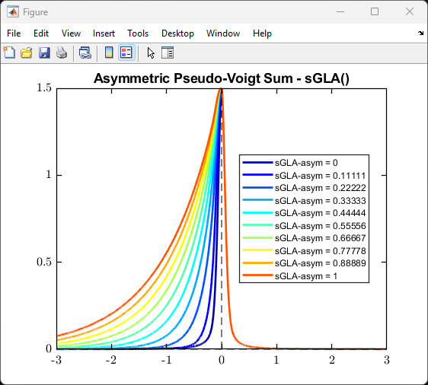
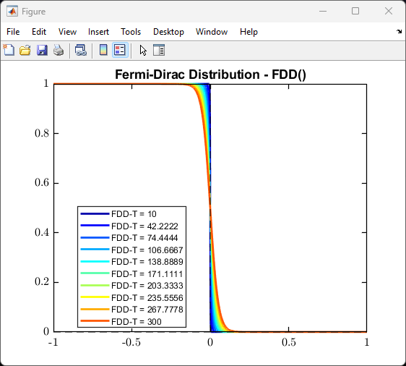
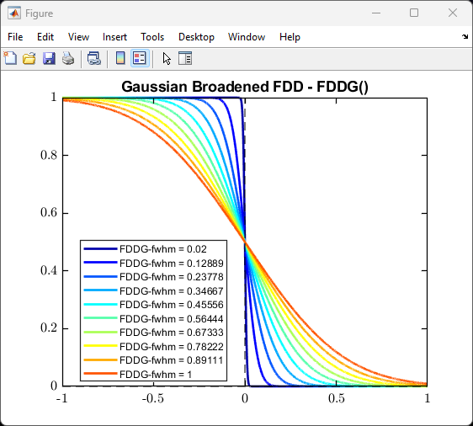
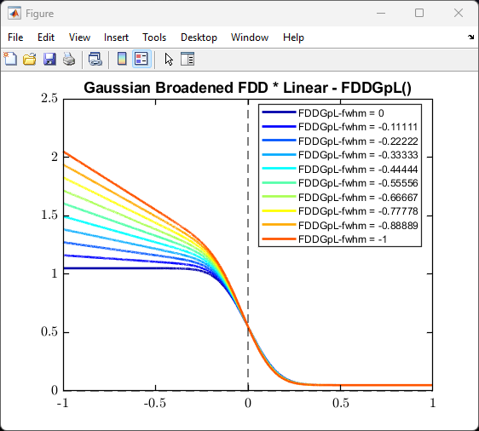
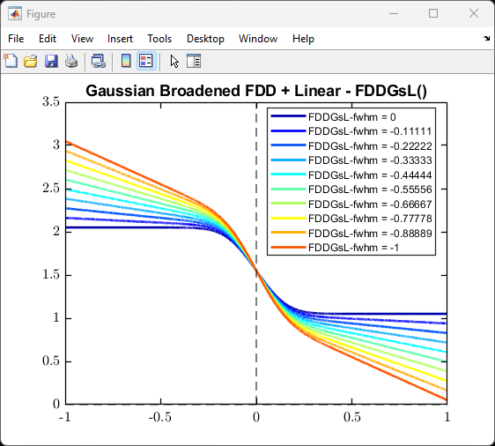
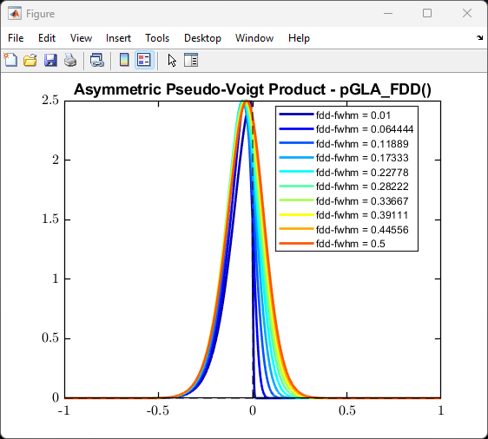
Showcase of the offered fundamental curve shapes

Slide 10
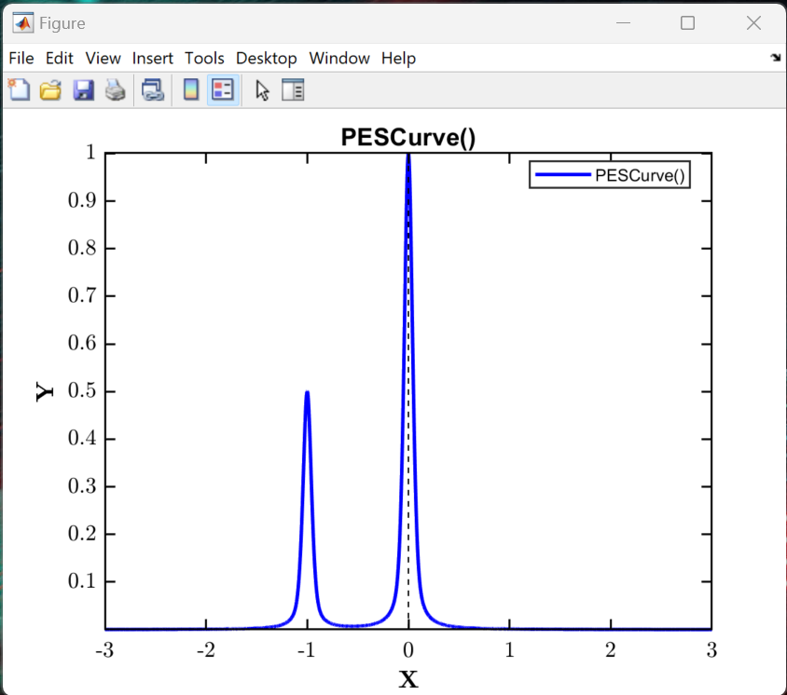
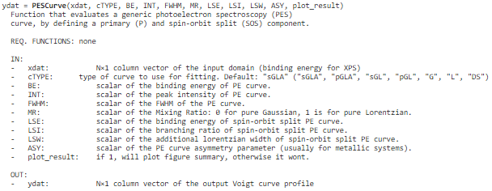
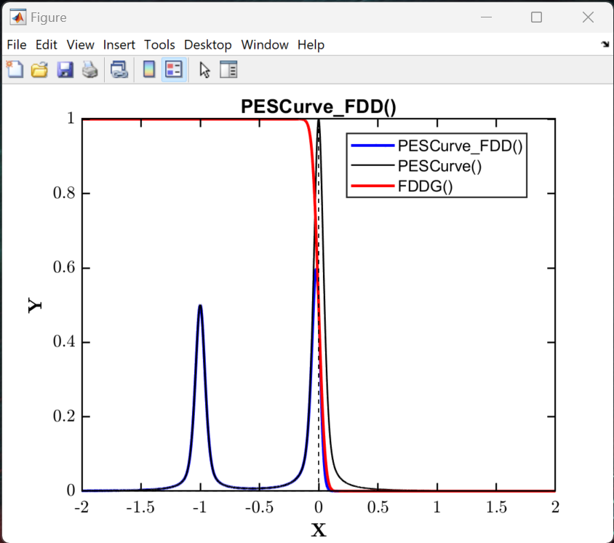
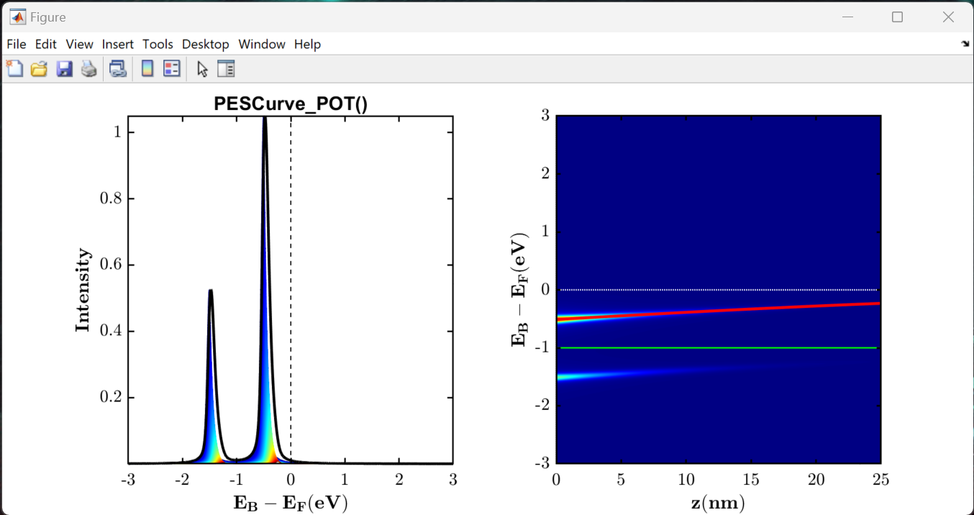
Showcase of the offered PES model curves
Use the PESCurve() function to generate a generalised PES model curve, defining a primary and spin-orbit split component.
A linear combination of these can be used to fit XPS data.
help PESCurve;
See ‘Example_003_PES_Model_Curves.mlx’ Live Script for examples.
PES Curve generated from the layer summation of a potential profile, enveloped over the IMFP.
PES Curve convolved with FDD at Fermi-edge

Slide 11
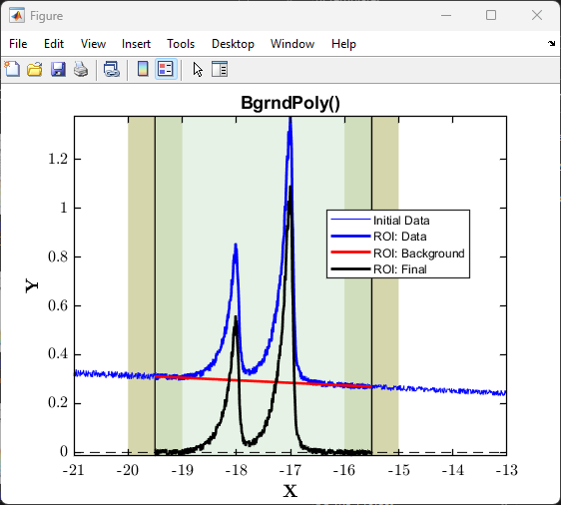
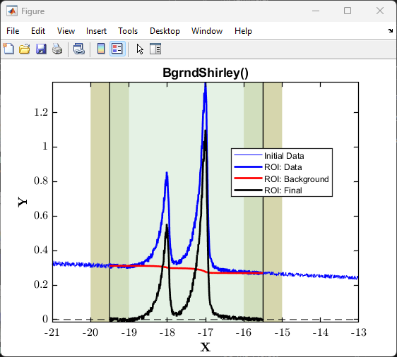

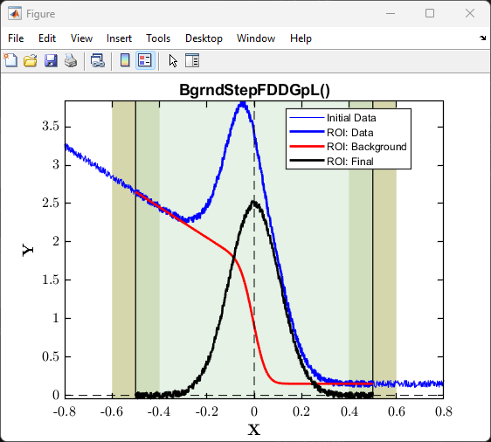
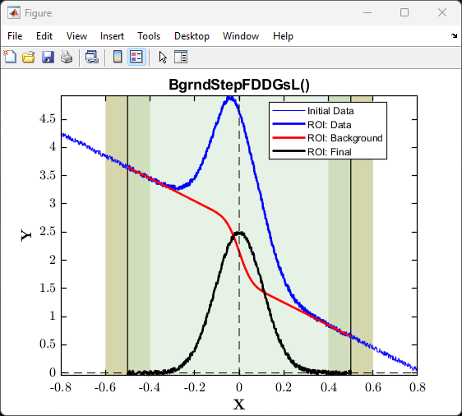
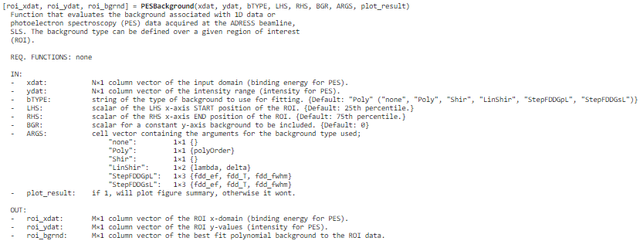
Showcase of the offered PES background curves
Use the PESBackground() function to call any of these background subtraction methods; polynomial, Shirley and linear step functions.
help PESBackground;
See ‘Example_003_PES_Background_Curves.mlx’ Live Script for example on how to use.

Slide 12
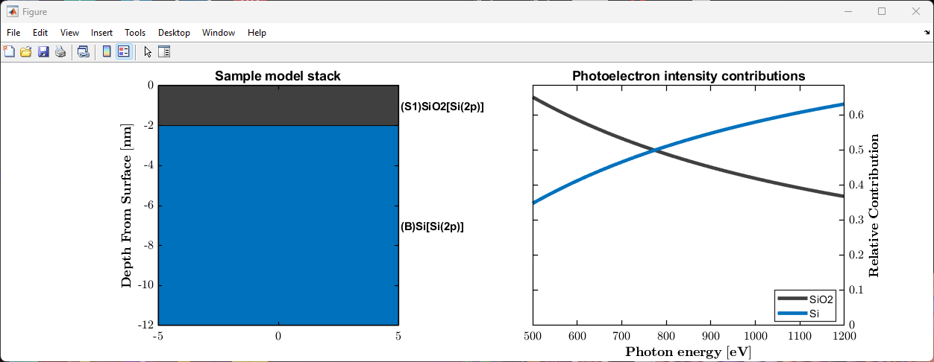
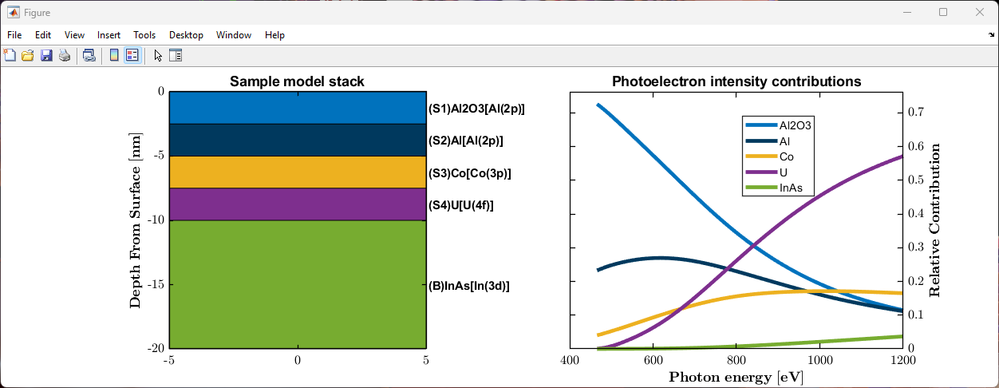
Simulating the photoelectron intensity contributions of an N-layered sample
pes_model_2L = nlayer_pes_model(500:1200, {'SiO2', 'Si'}, {'Si(2p)', 'Si(2p)'}, {2.0, Inf});
Tools can be used to fit the photon energy dependence of PES data.
nlayer_pes_model() function to simulate photoelectron intensity contributions of an N-layer model.
view_nlayer_pes_model() to quickly view solved model.
view_nlayer_sample() to quickly view the defined N-layer model sample stack.
overlayer_calc() to determine thickness of an overlayer on a bulk substrate using PES.
See ‘Example_020_Multilayer_PES_Modelling.mlx’ Live Script for example on how to use.

Slide 13
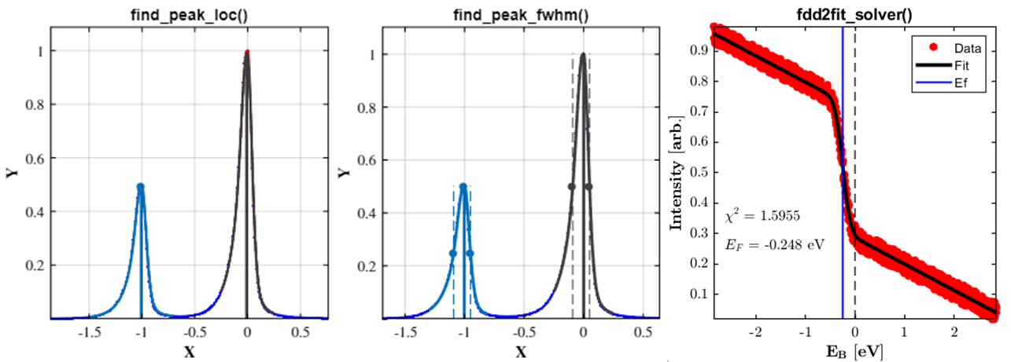
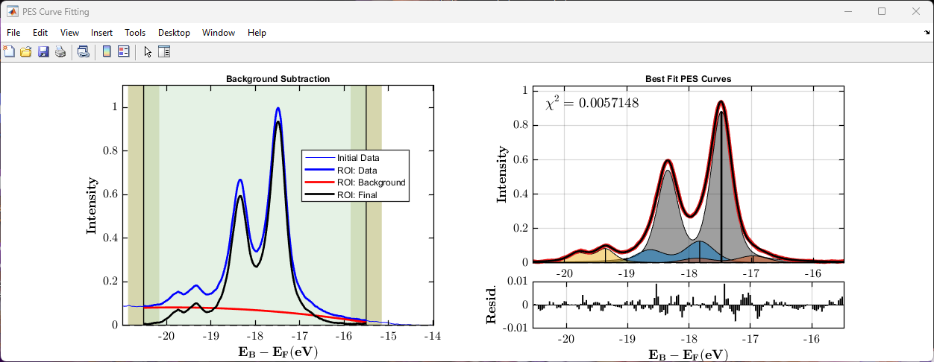
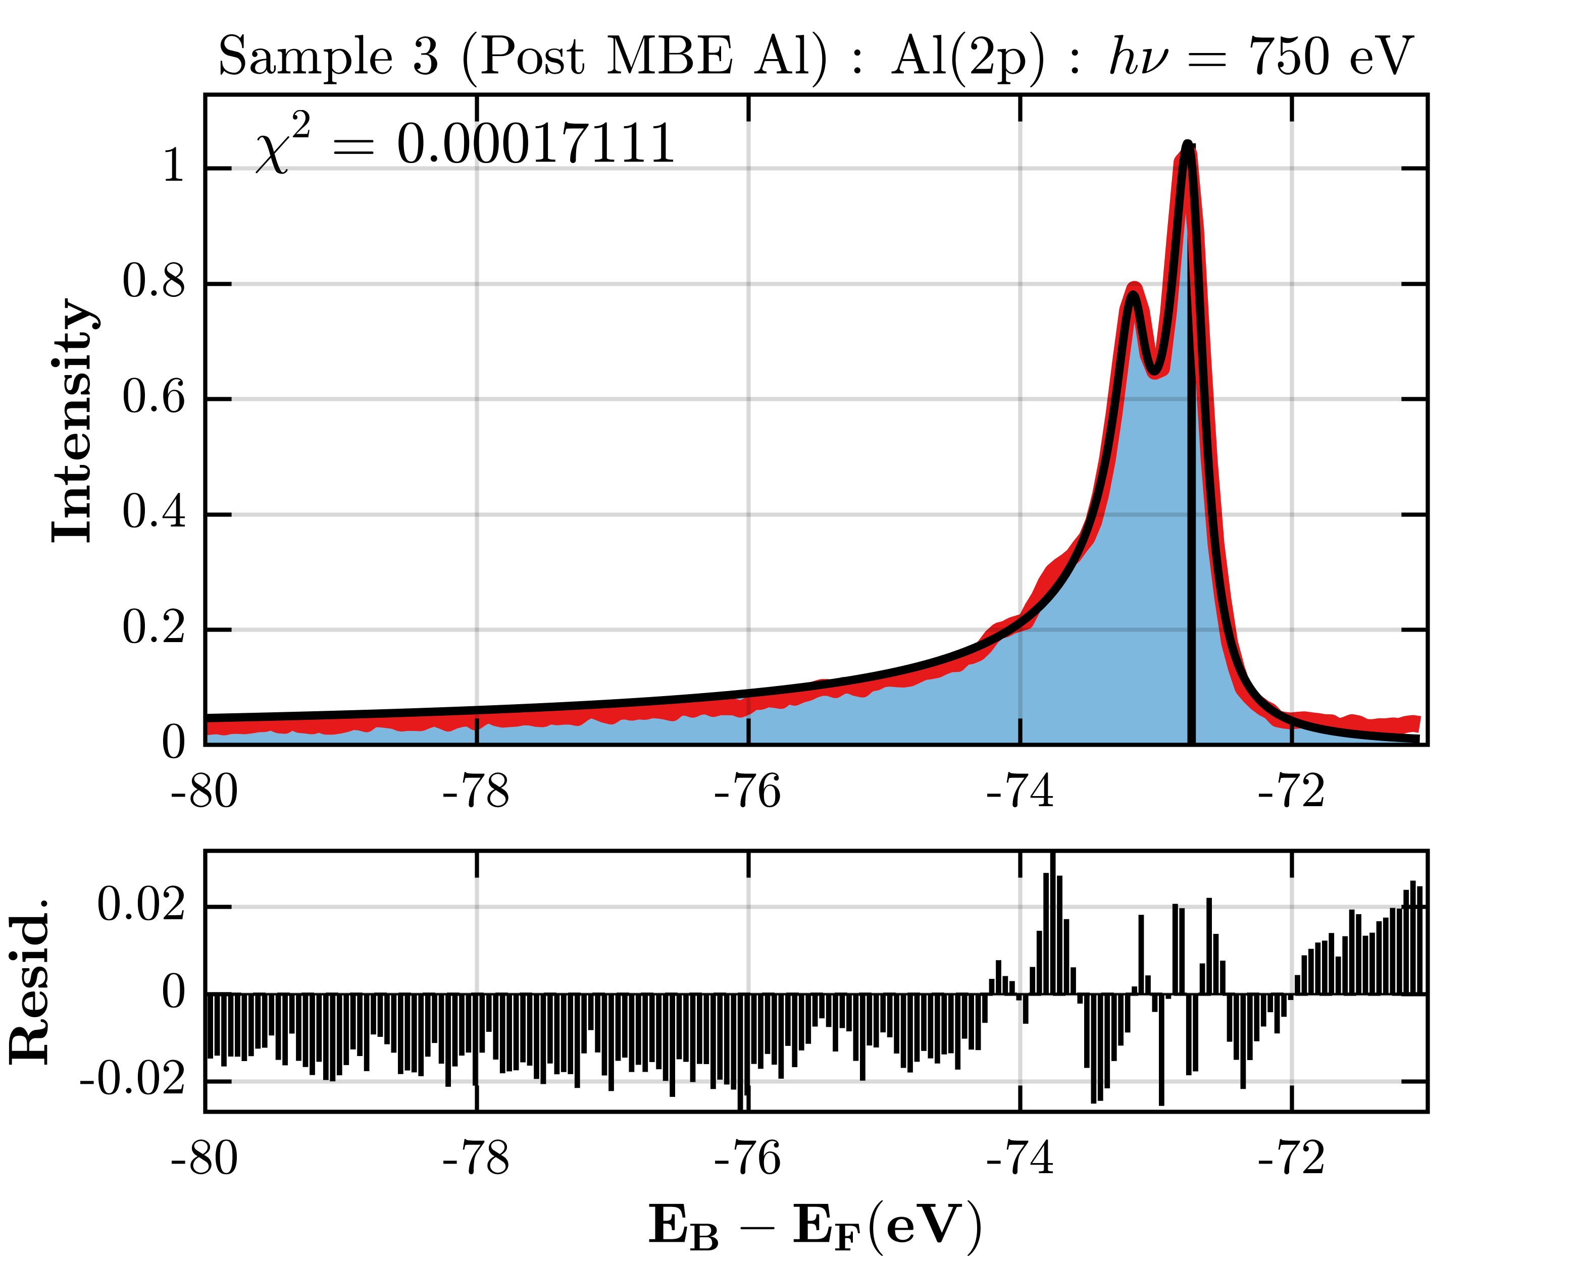



Showcase of curve fitting photoelectron spectroscopy data
Peak location finder
Example
Al(2p)
$hv$ = 550 eV
Peak FWHM finder
In(3d)
Example
$hv$ = 1150 eV
As(3d)
Fitting FDD for EB reference
See ‘Example_021-022_PES_Data_Fitting.mlx’ Live Script for an example on how to run the PES fitting routines.

